Slide 1
Introduction
To adapt to today’s landscape-oriented and high-definition monitors, the preferred format for Oracle corporate presentations is now 16:9. This package contains instructions, resources, sample slides, and a template for creating your own presentation in this aspect ratio. If you are preparing slides for a Webcast in the Oracle HQ studios, contact your producer or Leeann Myers (leeann.myers@oracle.com) for guidance in how to best format your content for Webcast delivery. Download the 16:9 template here: my.oracle.com/site/mktg/creative/creative
Tip: To use this package, save slides 1–51 as a new Microsoft PowerPoint file and name it “Oracle PPT Resources.” Use this new file as a graphic resource and instructional deck for creating future presentations. Save slides 52–66 as a separate PowerPoint file for creating your new presentation.
This is a self-service document. If you require support beyond the resources provided in this presentation, please contact Oracle’s Brand and Creative team, which will recommend a vetted and approved agency to support your request.

Slide 2
Table of Contents
Slides 3–21 Instructions and Guidelines
Slides 22–47 Graphic Resources
Slides 48–51 Sample Slides
Slides 52–66 Presentation Template

Slide 3
Reformatting 4:3 Presentation to 16:9
Open your 4:3 presentation, and open the new 16:9 template.
On the View tab, choose Window>Arrange All to display both presentations side-by-side on your monitor.
Add a new slide to the 16:9 template.
Copy the inside contents of your 4:3 slide and paste those contents inside the new slide on the 16:9 template. (Hold down your shift key to select and copy multiple items.)
Repeat this procedure slide by slide for all slides you want to reformat. DO NOT copy/paste the slide itself. Doing so can cause graphics and images to get stretched horizontally, resulting in oddly shaped people, circles turned into ovals, and distorted diagrams.
To resize individual graphic elements after they are copied into your 16:9 slide, select the graphic, hold the shift key to constrain the proportions, and drag in or out from one of the corner points.
Printing Your 16:9 Presentation
When printing your 16:9 presentation, make sure to select Landscape format and Scale to fit paper so that the entire slide prints onto standard-size paper.

Slide 4
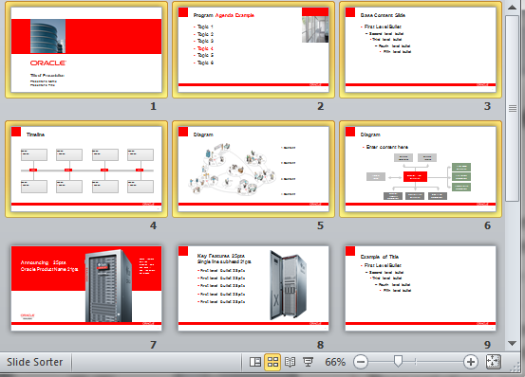
Transferring Slides Between Presentations
To copy/transfer slides between presentations of the same size:
Open presentation with slides to be transferred and click the Slide Sorter icon, as shown in the diagram.
Select slides to be transferred. On the Home tab, click Copy.
Open new presentation/template, display the slide sorter, click where you want your slides inserted, and choose Paste on the Home tab.
To copy/transfer slides between presentations of different sizes:
Select the slide content, not the slide, and paste the content inside the new slide―hold down your shift key to select and copy multiple items.
Repeat this procedure slide by slide for all slides you want to reformat. ATTENTION: DO NOT copy/paste the slide itself. Doing so can cause graphics and images to get stretched horizontally, resulting in oddly shaped people, circles turned into ovals, distorted diagrams, etc.
Selected slides
Slide sorter

Slide 5
Compatibility Issues
PowerPoint 2010 contains new filters and styles that are not supported on older versions of PowerPoint, such as– bevel, reflection, glow, multi-color gradient, etc. When an older version of PowerPoint opens a presentation that uses such filters/styles, it will not recognize it, and will convert it to an image. Content grouped to a beveled shape will be merged together and turned into a single image/picture that can no longer be modified. Text that uses beveled treatments will also be turned into images and lose all their editable characteristics.
To avoid such problems, PPT 2010 users should always create a separate box for content, and not group them with the shapes behind it.
If you are having compatibility issues, go to the link below and download the Compatibility Pack from Microsoft. microsoft.com/downloads/en/details.aspx?FamilyId=941b3470-3ae9-4aee-8f43-c6bb74cd1466&displaylang=en
When creating a new presentation, always start with a new template from the server. Reusing old presentations will spread problems. Updated template and images can be downloaded at the corporate branding site: my.oracle.com/site/mktg/creative/creative

Slide 6
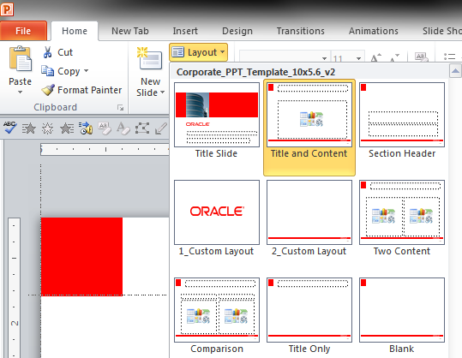
Template Guidelines
The template elements on the master slides may not be altered under any circumstances.
Never modify the shape or placement of the red bar, Oracle logos, or overall design.
The Oracle corporate presentation template has been carefully designed to adhere to Oracle’s brand guidelines.
Presentations and individual slides are frequently shared among Oracle presenters. If the template is altered by any individual, incorrect slides will be propagated throughout many presentations.
To apply a layout to a slide:
PowerPoint 2007–2010
On the Home tab, in the Slides group, click the arrow next to the Layout button. That will open a new window with different layouts from the template.
Click on the layout you want to use and it will be applied to your slide.
PowerPoint 2003
This version does not allow for multiple layouts. Users must copy and paste slides manually. (See slide 4 for Instructions)
PowerPoint 2007–2010 Template drop-down window

Slide 7
Information Protection Policy Classification
An information protection policy notice is built into the Master Template in the lower-left corner of the page. For all presentations created for internal use, this notice must be updated with the correct Confidential Information classification, which should not be altered.
Note: Presentations created for public consumption do not need to carry an information protection policy notice. They DO need to include the Oracle copyright notice as included in this template. Instructions for selecting the appropriate Confidential Information classification for your information protection policy notice or removing it from your template for a public-facing presentation are provided on the next slide:
The three Confidential classifications for Oracle’s information protection policy notice are:
Confidential – Oracle Internal: for information that must remain confidential to Oracle. e.g. Company-wide sendmails, employee training materials, internal company policies (certain policies, such as security policies, may require a higher level of classification).
Confidential – Oracle Restricted: for information that must remain confidential to Oracle and for which unauthorized disclosure could be reasonably expected to result in damage to Oracle’s business. e.g. Internal customer system configurations and requirements, competitive analyses, employee personal contact information, customer contracts and ordering documents, budget information, contracts and proposals from vendors, organization charts.
Confidential – Oracle Highly Restricted: for information that must remain confidential to Oracle and for which unauthorized disclosure could be reasonably expected to result in significant damage to Oracle’s business. e.g. Strategic business plans such as acquisition plans, encryption keys, information used to authenticate an individual, source code, unannounced financial results, sensitive employee information (Social Security number/national identifier, certain health information, etc.), unfixed product security vulnerabilities.
More information about information protection and classification can be found in the Information Protection Policy.

Slide 8
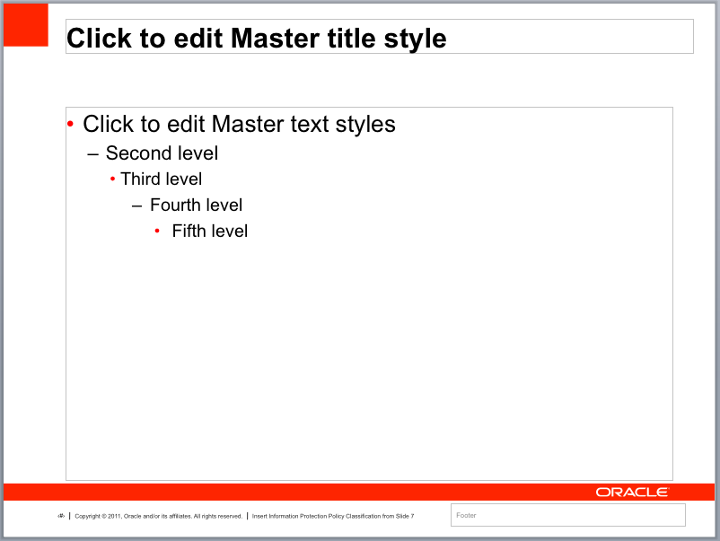
Updating Confidential Classification
To update the Confidential Information classification:
1. Copy the correct classification for your presentation from the options below:
2. On the View tab, click Master > Slide Master.
3. Click the Master Slide located at the top of the sidebar.
4. When the Master Slide is displayed, select the Protection Policy Notice in the footer.
5. Paste the correct classification for your presentation.
6. Close the Master View.
To remove the Confidential Information classification:
1. On the View tab, click Master > Slide Master.
2. Click the Master Slide located at the top of the sidebar.
3. Delete Protection Policy Notice.
4. Close the Master View.
PowerPoint 2007–2010 Master Slide View
Confidential – Oracle Internal
Confidential – Oracle Restricted
Confidential – Oracle Highly Restricted
Protection Policy Notice

Slide 9



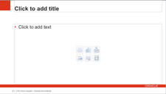


Slide Sequence
Standard Opening Slide Sequence
The opening slide is reserved for the Oracle logo.
The format of the standard title slide should never be altered. When co-presenting, a partner logo in the lower right is acceptable; in addition, a product logo in the upper right is allowed. Title of the presentation, presenter names, and photo may be customized.
The standard closing slide sequence should be the “Hardware and Software, Engineered to Work Together” slide, followed by the Oracle logo slide.
When appropriate, an acquisition logo can be placed on the second slide in your presentation (for further details, see the communications and branding guidelines for the acquired company in question available on the corporate branding site at my.oracle.com/site/mktg/creative/creative.)
Logo
Standard Closing Slide Sequence
Event Slide Sequence

Slide 10

Product Logo Placement
Acceptable Logo Placement
Product, service, or internal program logos can be placed in the upper right of the title slide. Please do not alter the template by placing these logos on content slides or in the image area.
Logo
Unacceptable Logo Placement
Logo
Logo

Slide 11
Font Usage
Arial is the ONLY font that should be used in the Oracle corporate presentation template.
Times and other serif fonts are not acceptable.
Arial
Times

Slide 12

Inserting and Scaling Images
To insert photography, choose Insert > Picture from File or Insert > and click on the picture icon.
To scale an image, select a corner and drag. Always hold the shift key, to preserve the image proportions.
The library of approved images is located at the corporate branding site, my.oracle.com/site/mktg/creative/graphics/photography.
Select images that are appropriate for the specific presentation. “Business” and “business lifestyle” images may be substituted when industry-specific images are not appropriate.

Slide 13
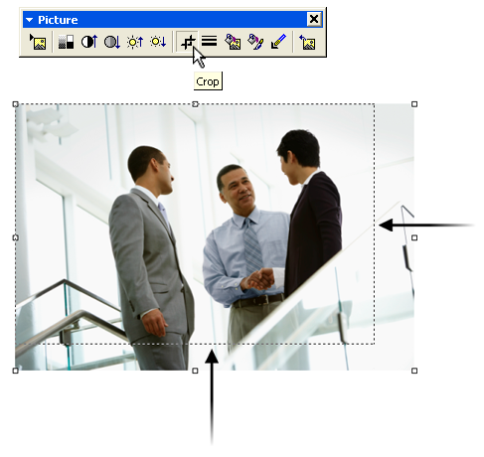
Cropping Images
Select the image you want to crop. On the Format tab, in the Size group, click the Crop tool and drag the image bounding box to the desired size.

Slide 14
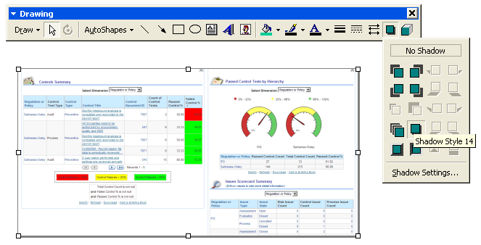
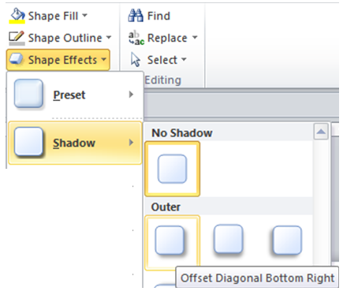
Screenshot Treatment
It is preferred that all screenshots have a drop shadow treatment.
PowerPoint 2003:
Select the image, click the Shadow button on the Drawing toolbar and select Shadow Style 14.
PowerPoint 2007–2011:
Select the image, click the Shape Effects > Shadow and select the Offset Diagonal Bottom Right option.

Slide 15
Changing Measurement Units
By default, the ruler in PowerPoint displays measurements in inches. If you want to view and work with centimeters, you must configure Microsoft Windows. You cannot change the measurement units directly in PowerPoint.
1. In Windows click Start, and then click Control Panel.
2. Double-click Regional Options or Regional and Language Options.
The options that appear are different for each version of Windows:
If you are working in Windows XP, click the Regional Options tab, and then click Customize. On the Numbers tab, in the Measurement system list, click Metric.
If you are not using Windows XP, look for a Numbers option that includes a Measurements setting, and then change the value to Metric.
3. Apply the changes, and then start PowerPoint.
The rulers will now display measurements in the system that you have chosen. Tip: To change back from centimeters to inches, select U.S. from the Measurement System drop-down list.

Slide 16
Capitalization, Punctuation, and Writing Style
The title of each slide should be in title case, which means that the first and last words and all words except prepositions longer than four letters (about, without, etc.), articles (a, the, etc.), and conjunctions (and, so, but, etc.) are capitalized.
Bulleted text should be written in sentence case, which means that only the first word of each sentence and proper nouns are capitalized.
Bulleted items should be parallel in structure and punctuation (for example, all items as full sentences OR all items as sentence fragments).
When bulleted items are not complete sentences, no end punctuation is required. Exception: If a single bullet entry includes more than one full sentence, then each sentence in that bullet entry requires a period, and all items in that bullet list also require periods.
Slide titles and bulleted text should be short and concise.
If a title doesn’t fit within the text box specified on the template, do not modify the size of the text box; consider shortening the slide title instead.
For more information, visit my.oracle.com/site/mktg/creative/services/editorial and download the Oracle editorial style guide.

Slide 17
Formatting Slides for Video Display
Presentations are frequently recorded for playback from tape or DVD, and television screens often clip the outer edges of the slides.
All text and graphics should be kept within the video title live area (shown by the white area on this slide; the gray edge shows the area of a slide which may be clipped) to avoid this clipping.

Slide 18
Embedding Video
To embed MPEG media into a PowerPoint slide:
1. On the Insert tab, in the Media Clips section, click Movie > Movie from File.
2. Locate the movie file you want to insert and click OK.

Slide 19
Safe Harbor Statements
One of the following slides must be used if your presentation covers material affected by Oracle’s Revenue Recognition Policy.
To learn more about this policy, e-mail: Revrec-americasiebc_us@oracle.com

Slide 20
The preceding is intended to outline our general product direction. It is intended for information purposes only, and may not be incorporated into any contract. It is not a commitment to deliver any material, code, or functionality, and should not be relied upon in making purchasing decisions. The development, release, and timing of any features or functionality described for Oracle’s products remains at the sole discretion of Oracle.

Slide 21
The following is intended to outline our general product direction. It is intended for information purposes only, and may not be incorporated into any contract. It is not a commitment to deliver any material, code, or functionality, and should not be relied upon in making purchasing decisions. The development, release, and timing of any features or functionality described for Oracle’s products remains at the sole discretion of Oracle.

Slide 22
Oracle Color Palette
R=255
G=0
B=0
R=0
G=0
B=0
R=127
G=127
B=127
Primary Palette
R=211
G=202
B=175
R=91
G=105
B=129
R=130
G=158
B=126
Secondary Palette
R=159
G=179
B=169
R=200
G=204
B=148
R=201
G=201
B=201
Tertiary Palette
R=0
G=112
B=192
Hyperlinks

Slide 23
Vertical Bar Chart
Chart Title

Slide 24
Horizontal Bar Chart
Chart Title
Notes:
24

Slide 25
Line Chart
Chart Title
Notes:
25

Slide 26
Stacked Bar Chart
Chart Title
Notes:
26

Slide 27
Pie Chart
Chart Title
Notes:
27

Slide 28
Various Charts
Header
Header
Header
Notes:
28

Slide 29
Venn Diagram: Three Circles
Content
Content
Text
Text
Text
Text
Content

Slide 30
Venn Diagram: Four Circles
Content
Content
Text
Text
Text
Content
Content
Text
Text

Slide 31
Diagram: Four Boxes
Text
Text
Text
Text
Text

Slide 32
Arrows and Graphic Elements

Slide 33
Customized Arrows
Grouped
Separate

Slide 34
Tables
Title
Bullet
Title
Bullet

Slide 35
Tables
Title
Bullet
Title
Bullet
Title
Bullet

Slide 36
Tables
Title | Title
Insert content here | Insert content here
Insert content here | Insert content here
Insert content here | Insert content here
Insert content here | Insert content here
Insert highlighted content here | Insert highlighted content here
Insert content here | Insert content here

Slide 37
Tables
 | Title | Title
Label | Text Bullet Bullet | Text Bullet Bullet
Label | Text Bullet Bullet | Text Bullet Bullet
Label | Text Bullet Bullet | Text Bullet Bullet

Slide 38
Tables
 | Title | Title | Title | Title | Title | Title
Label | ✓ | ✓ | ✓ | ✓ | ✓ | ✓
Label | ✓ | ✓ | ✓ | ✓ | ✓ | ✓
Label | ✓ | ✓ | ✓ | ✓ | ✓ | ✓
Label | ✓ | ✓ | ✓ | ✓ | ✓ | ✓

Slide 39
Tables
 | Title | Title | Title | Title | Title | Title
Label | 00.00 | 0.00 | 000.00 | 00.00 | 00.00 | 00.00
Label | 0.00 | 00.00 | 0.00 | 0.00 | 0.00 | 0.00
Label | 000.00 | 0.00 | 00.00 | 0.00 | 0.00 | 000.00
Label | 0.00 | 000.00 | 0.00 | 000.00 | 00.00 | 00.00
Numbers should align right, to decimal point

Slide 40
Tables
 | Title | Title
 | Subtitle | Subtitle
Label | Text Bullet Bullet | Text Bullet Bullet
Label | Text Bullet Bullet | Text Bullet Bullet
Label | Text Bullet Bullet | Text Bullet Bullet

Slide 41
List
1
Text
2
Text
3
Text
4
Text
5
Text
6
Text
7
Text
8
Text
9
Text
10
Text

Slide 42



















Oracle Corporate Photography
To download these and other nonwatermarked images, please go to my.oracle.com/site/mktg/creative/graphics/photography.

Slide 43










Oracle Corporate Photography
To download these and other nonwatermarked images, please go to my.oracle.com/site/mktg/creative/graphics/photography.

Slide 44


















Oracle Corporate Icons
Academic
Accelerate Any
Web Application
Accelerator Service
Access
Acquire Customer
Intelligence
Add Item to Cart
Ad Hoc Query
Administration
Administrative Server
Admitting
Advanced Product
Services
Advertising
Advanced Security
Allocate
Analysis
Analyze Enterprise
Application
Application Development
Additional corporate icons are located on my.oracle.com/site/mktg/creative/graphics.

Slide 45












Oracle Corporate Logos
This is the Oracle Jiaguwen logo.
It can only be used in Greater China.
Additional corporate icons are located on my.oracle.com/site/mktg/creative/logos.

Slide 46



Oracle Partner or Customer Logos
(Up to 18 logos)
To fit a logo into the displayed maximum size and keep its graphic proportions, select the logo, press the Shift key, and drag a resizing handle in or out.
FPO
FPO
FPO
Maximum size for horizontal logo
Maximum size for square logo
Maximum size for vertical logo

Slide 47
Oracle Partner or Customer Logos
(Up to 28 logos)
To fit a logo into the displayed maximum size and keep its graphic proportions, select the logo, press the Shift key, and drag a resizing handle in or out.
FPO
FPO
FPO
Maximum size for horizontal logo
Maximum size for square logo
Maximum size for vertical logo

Slide 48

Case Study
Title
Title
Title
Title
Head
Subhead
Head
Subhead
Head
Subhead
Head
Subhead
Content here
Content here
Content here
Content here
Content here
Content here
Content here
Content here

Slide 49
Diagram
Accounts
Receivable
Accounts Payable
Fixed Asset
Accounting
General
Ledger
Advanced Cost Accounting
Procurement
Management
Transportation
Management
Advanced
Inventory
Management
Manufacturing
Accounting
Sales Order
Management

Slide 50
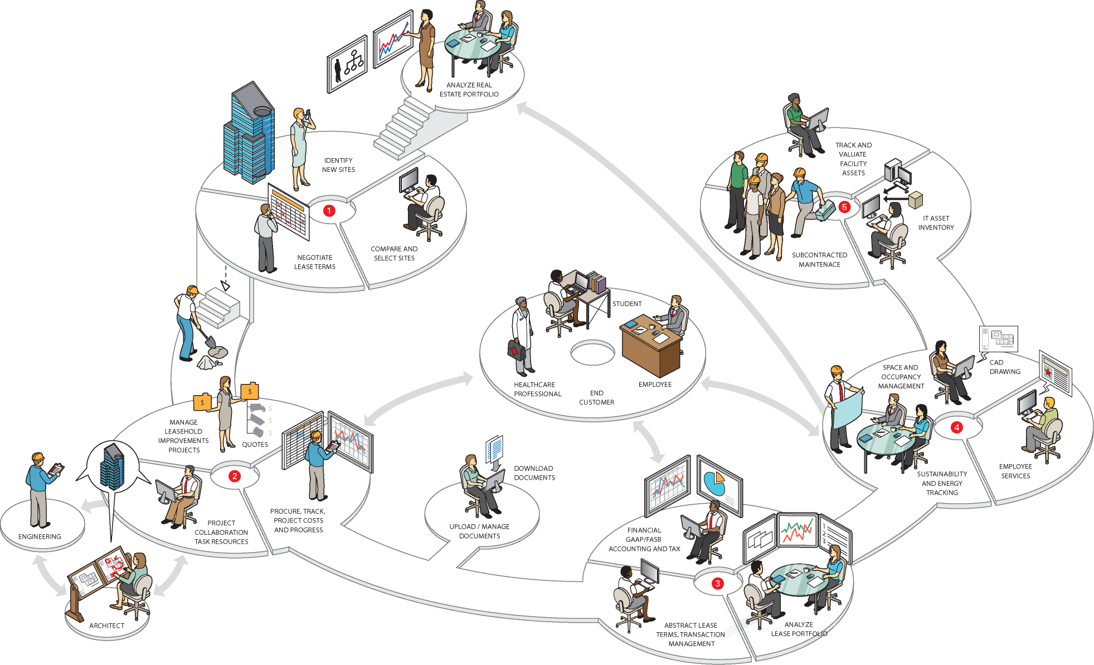
Diagram
1. Content
2. Content
3. Content
4. Content

Slide 51
Timeline
Content
Content
Content
Content
Content
Content
Content
Content
2008
2009
2010
2011
Content
Content
Content
Content
Content
Content
Content
Content

Slide 53

ORACLE
PRODUCT
LOGO
Presenting with
LOGO

Slide 54



Slide 55

Latin America 2011
December 6–8, 2011
Tokyo 2012
April 4–6, 2012

Slide 56

Oracle OpenWorld Bookstore
Visit the Oracle OpenWorld Bookstore for a fabulous selection of books on many of the conference topics and more!
Bookstore located at Moscone West, Level 2
All Books at 20% Discount

Slide 57

Program Agenda
Topic 1
Topic 2
Topic 3
Topic 4
Topic 5
Topic 6

Slide 58
Program Agenda
Topic 1
Topic 2
Topic 3
Topic 4
Topic 5
Topic 6

Slide 61

Announcing
Oracle Product Name
ORACLE
PRODUCT
LOGO

Slide 62

Key Features

Slide 63
“This slide format serves to call attention to a quote from a prominent customer, executive, or thought leader in regards to a particular topic.”
Name
Title, Company Name
CUSTOMER LOGO

Slide 64
Q&A

Slide 65



